Slide 1

A Rule-Based Music Recommendation System Based on Depression Levels of User Posts Extracted From Social Networks
Presented By
Md Ashed Dewan(CSE212015)
Under The Guidance of
Mr. Zafar Sarif &
Mrs. Moumita Chatterjee
Assistant Professor of
Aliah University, Newtwon
Dept of Computer Science and Engineering

Slide 2
Contents
Introduction
Motivation
Literature survey
Problem statement
Objectives
Proposed model
Dataset
Data preprocessing
Word cloud
Feature extraction
Word2vec word embeddings
ML classification results
LSTM Classification results
Recommendation system
Future Work
Conclusion
References

Slide 3
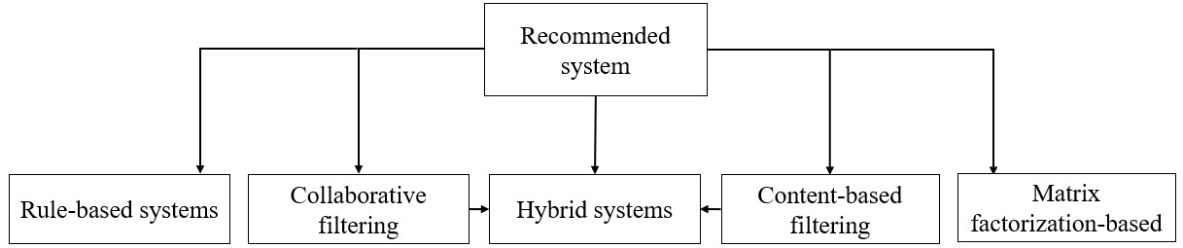
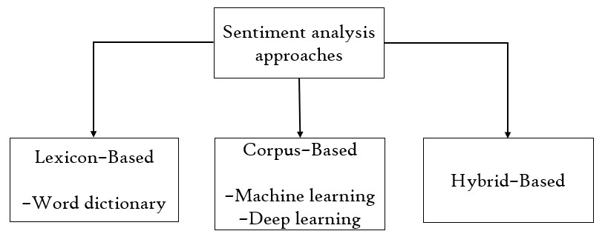
Introduction
Sentiment analysis
Recommended system
Rule-based music recommendation system
Reinforcement
Learning-Based

Slide 4
Motivation
In present scenario the use of social media is increasing day by day.
5% adults suffer from depression in world-wide.
Music has the power to influence our emotions and mood, and for many people, it can provide comfort during difficult times.
Mood enhancement, Relaxation and stress reduction, Connection and empathy.

Slide 5
Literature Survey
Owner | Literature Name | Publication
Abdul Hasib Uddin et al. | Depression Analysis from Social Media Data in Bangla Language using Long Short-Term Memory (LSTM) Recurrent Neural Network Technique | International Conference on Computer, Communication, Chemical, Materials and Electronic Engineering (IC4ME2), 11-12 July 2019 | Applied six different algorithms to predict almost high accuracy. Among them, the Multinomial Naive Bayes provide us the maximum accuracy which is 86.67%.
Renata L. Rosa et al. | Music Recommendation System Based on User’s Sentiments Extracted from Social Networks | 2015 IEEE | Predict through a Convolutional Neural Network (CNN) and a Bi-directional Long Short-Term Memory (BLSTM), the proposed method reached an accuracy of 0.89 and 0.90 to detect depressed and stressed users respectively
Moumita Chatterjee et al. | Suicide ideation detection from online social media: A multi-modal feature-based technique | International Journal of Information Management Data Insights 2022 | Feature Extraction Emojis/Emoticons Sentiment, LDA features, TF-IDF, Linguistic features (N-Gram+TF-IDF) and LDA to achieve an accuracy of 87% using the SLogistic regression classifier classifier.

Slide 6
Literature Survey
Owner | Literature Name | Publication | Method
Piyush Kumar et al. | Feature Based Depression Detection from Twitter Data Using Machine Learning Techniques | Journal of Scientific Research of The Banaras Hindu University, 2022 | Feature Extraction Emojis/Emoticons Sentiment, LDA features, TF-IDF, Linguistic features (N-Gram+TF-IDF) and LDA to achieve an accuracy of 89% using the Support Vector Machine classifier.
Diki Wahyudi et al. | Deep Learning for Multi-Aspect Sentiment Analysis of TikTok App using the RNN-LSTM Method | Building of Informatics, Technology and Science (BITS), Published: 30/06/2022 | Use Long Short-Term Memory (RNN – LSTM) model and the addition of word embedding BERT. Highest accuracy which is 91.00%.
Renata L. Rosa et al. | A Knowledge-Based Recommendation System That Includes Sentiment Analysis and Deep Learning | IEEE TRANSACTIONS ON INDUSTRIAL INFORMATICS, APRIL 2019 | Predict through a Convolutional Neural Network (CNN) and BLSTM the proposed method reached an accuracy of 0.89, With Emotional Health Monitoring System, eSM2 sentiment matrix and user details inform health condition.

Slide 7
Problem Statement
Depression detection and music recommended system on these two a lot of work done differently, but after depression detection music recommendation system worked is rarely. I have tried to represent Depression detection and music recommended system together.

Slide 8
Objectives
Identifying the sentiment of text data.
Feature Extraction
Add word-embedding to classify for more accurate result.
Improving decision-making
And finally built a music recommended system based on user sentiment.

Slide 9
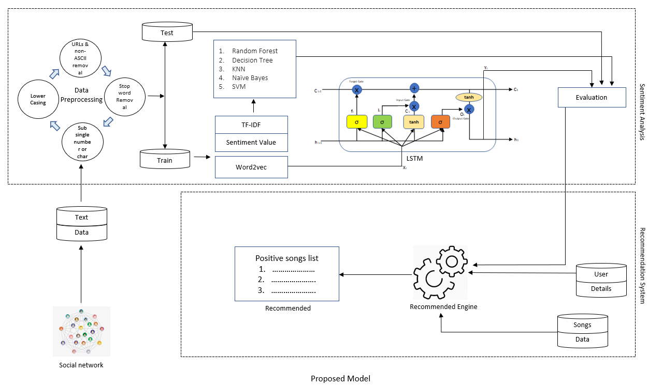
Proposed Model

Slide 10
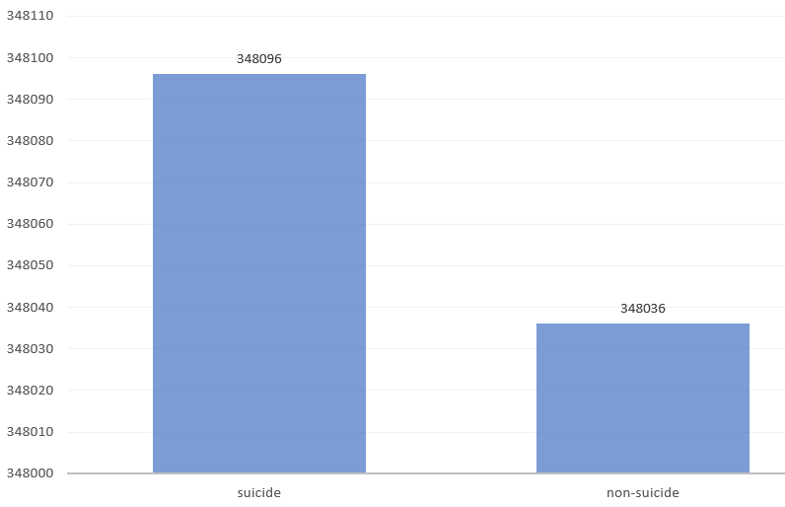
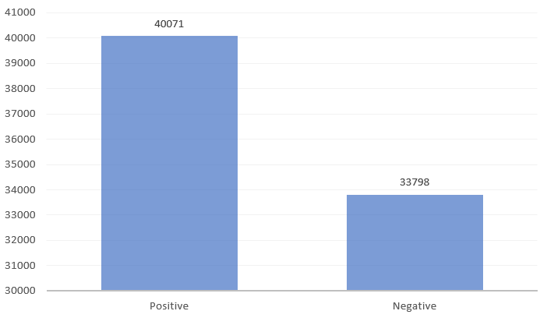
Dataset
The name of the dataset is “Suicide and Depression Detection”, it’s from Kaggle, contain 3 column and 232074 row, target variable either suicide or non-suicide.
The dataset is a collection of posts from the "SuicideWatch" and "depression" subreddits of the Reddit platform using Pushshift API.
2nd depressive dataset collected from 227 twitter user, scratch using Twitter API. contain 3 column and 24624 row, target variable Positive of Negative,.

Slide 11
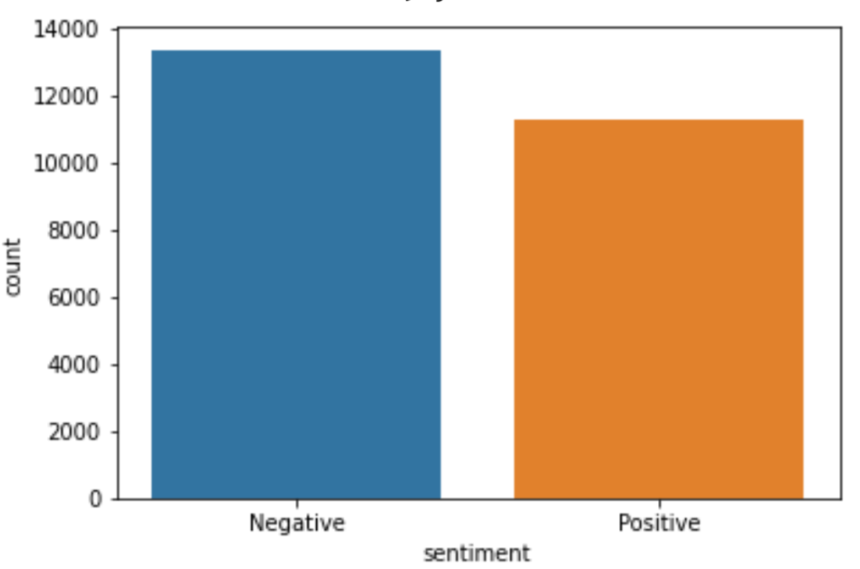
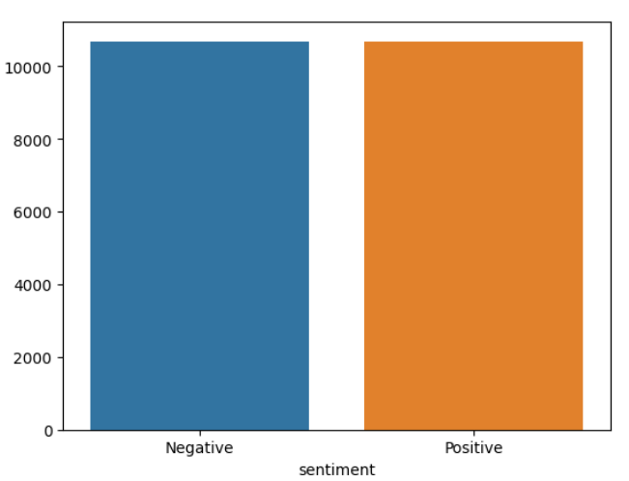
Data Preprocessing
Special Charter & URLs
Data Preprocessing
Lower casing
Special charterer, URLs, email removing
Stop words removing
Lemmatization
Data up sampling
Train Test splitting with 80% 20%
Data
Preprocessing
Tweets
Lower Casing
Stop Words Removing
Data
Lemmatization
Test Data
Data
Data Splitting
Up Sampling
Train Data

Slide 12
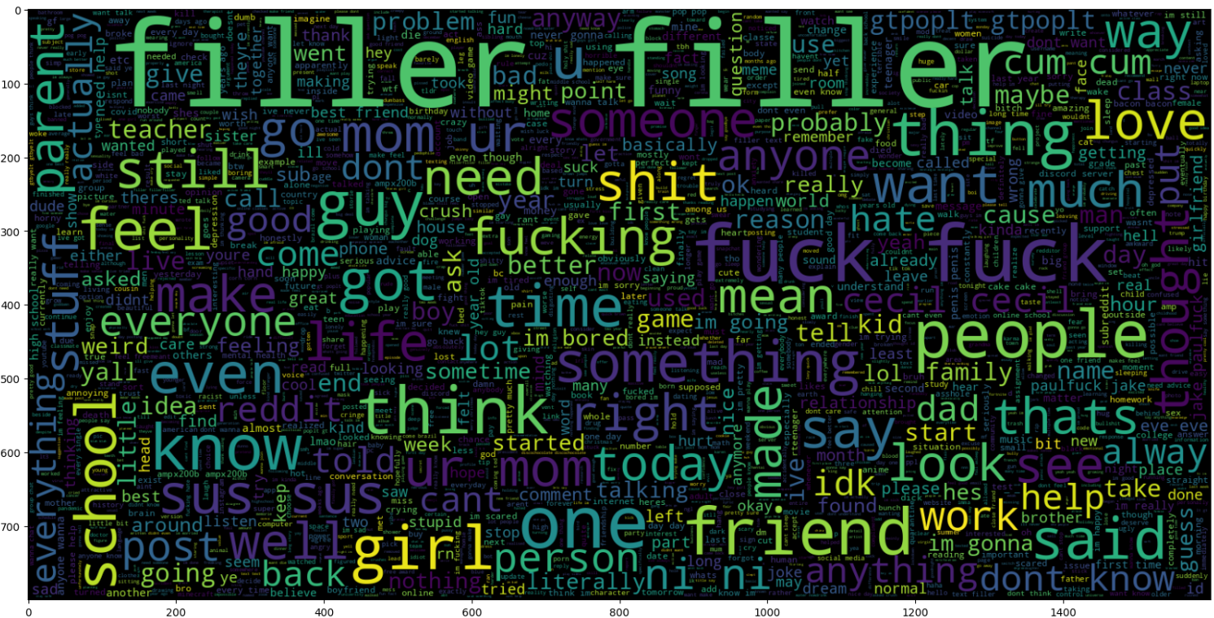
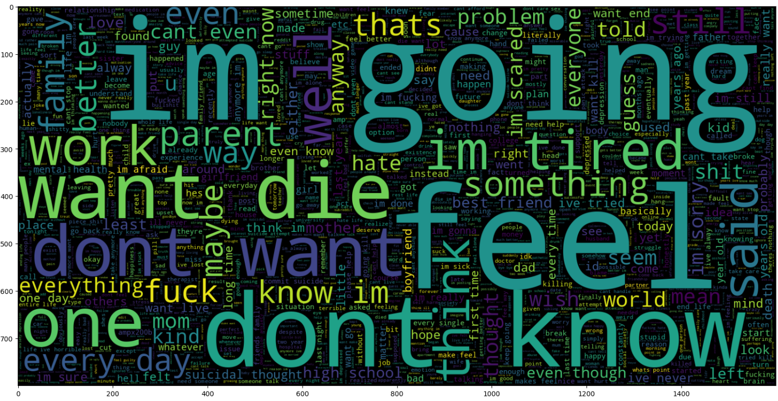
Word Cloud
Non-Suicidal Word
Suicidal Word

Slide 13
Feature Extraction
TF-IDF : To extract unigrams and bigrams using Tf-Idf vectorizer.
Sentiment value: Using SentiWordNet library to calculate Subjectivity, Polarity. Subjectivity between 0 to 1, and Polarity between -1 to +1. Low Subjectivity and negative Polarity consider as depressive text.
Word2vec: Word2vec word embeddings is a technique where individual words are transformed into a numerical representation of the word (a vector). These numerical representations do identify similarity or dissimilarity between words.

Slide 14
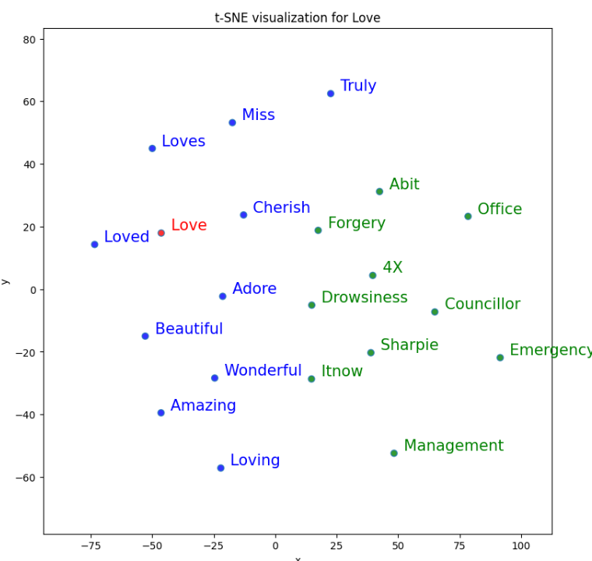
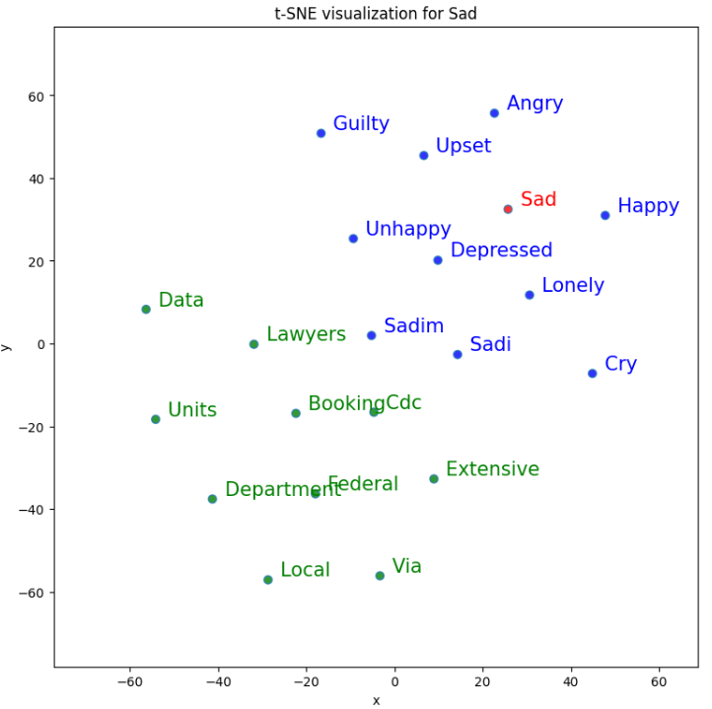
Word2vec Word Embeddings

Slide 15
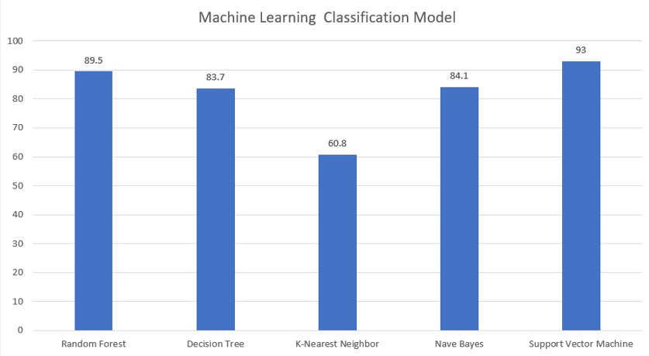
Machine Learning Classification results
With IF-IDF features I used different five classification model. 1.Decision Tree, 2.Random Forest, 3.K-Nearest Neighbor (KNN), 4.Support Vector Machine (SVM), 5.Nave Bayes.
Class | RF | DT | KNN | NB | SVM
Accuracy | 89.5 | 83.7 | 60.8 | 84.1 | 93
Precision | 0.90 | 0.84 | 0.72 | 0.85 | 0.94
Recall | 0.90 | 0.84 | 0.61 | 0.84 | 0.94
F1-Score | 0.90 | 0.84 | 0.55 | 0.84 | 0.94
Machine Learning Classification results

Slide 16
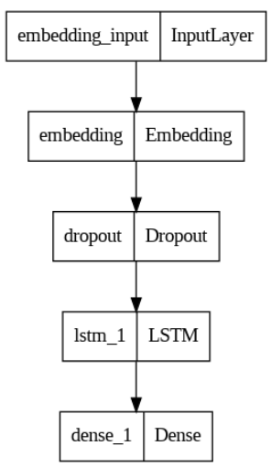
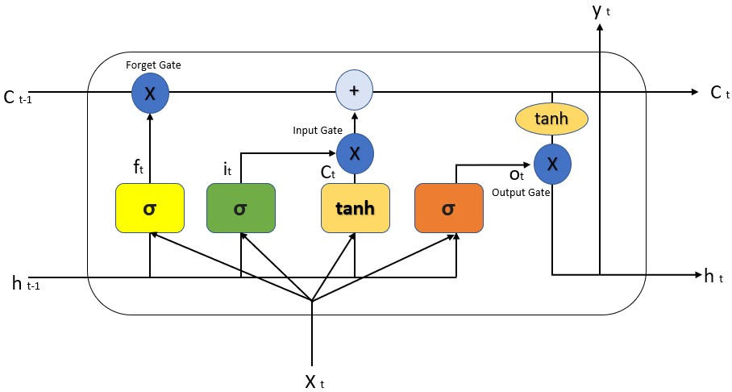
LSTM Classification results
With word2vce embedding layer build a five-layer model. The performance of the model in test data get 95% accuracy.
 | Precision | Recall | F1-score | Support
0 | 0.94 | 0.96 | 0.95 | 23202
1 | 0.95 | 0.94 | 0.94 | 23206
Micro avg | 0.95 | 0.95 | 0.95 | 46408
Macro avg | 0.95 | 0.95 | 0.95 | 46408
Weighted avg | 0.95 | 0.95 | 0.95 | 46408
Samples avg | 0.95 | 0.95 | 0.95 | 46408
 | With Word2vec | Without Word2vec
Accuracy | 0.95 | 0.93
Precision | 0.95 | 0.94
Recall | 0.95 | 0.94
F1-Score | 0.95 | 0.94
LSTM

Slide 17
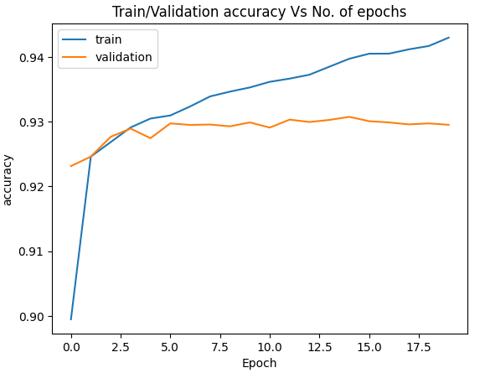
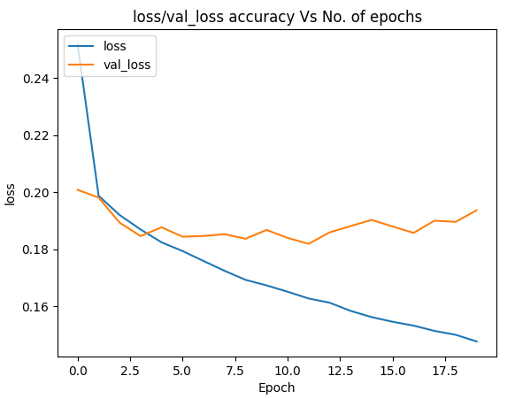
LSTM Classification results

Slide 18
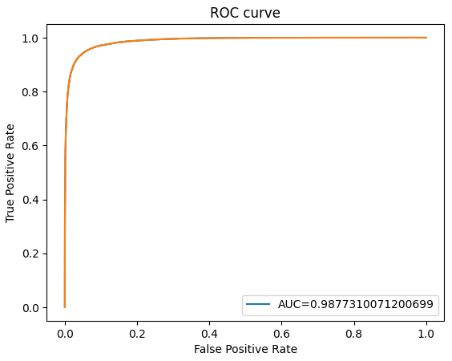
LSTM Classification results
 | 0 | 1
0 | 44768 | 1428
1 | 2460 | 44162
Confusion Matrix

Slide 19

Recommendation System
1. User age, gender, type of song and tweets taken as input.
2. Build a recommendation engine to predict text sentiment by sentiment value.
3. If maximum tweets are positive then we consider user as Non-depress, if maximum tweets are negative then we consider user as Depress and recommended a positive song list.
User Tweets
Non-depress/Neutral
Maximum Sentiment Positive/ Equal
User Tweets
Positive songs list
…………………
………………….
………………….
Recommendation
Engine
Music
Positive Song
Maximum Sentiment Negative
Data
Recommended

Slide 20
Future Work
Improved feature engineering.
Divide recommended system in server side and client side.
Move from Content-based recommended System to Collaborative recommended system for better result.
Using sensor base dataset for more accurate result.

Slide 21
Conclusion
In conclusion, sentiment analysis using long short-term memory (LSTM) models is a powerful and widely used technique for analyzing and understanding the sentiment of text data and user depression in individuals. And recommended system gives a basis relaxion with music.
However, it is important to note that sentiment analysis and recommended system is not a replacement for professional diagnosis and treatment. It is recommended that individuals who may be experiencing depression seek the help of a qualified healthcare professional.
In future I develop Glove and Bart Word Embedding model also move from Content-based recommended System to Collaborative recommended system for better result.

Slide 22
Reference
Renata L. Rosa , G. Maria Schwartz , Wilson Vicente Ruggiero, and Demóstenes Z. Rodriguez, “A Knowledge-Based Recommendation System That Includes Sentiment Analysis and Deep Learning”, IEEE TRANSACTIONS ON INDUSTRIAL INFORMATICS, APRIL 2019
Renata L. Rosa, Demóstenes Z. Rodríguez, and Graça Bressan, “Music Recommendation System Based on User’s Sentiments Extracted from Social Networks ”, 2015 IEEE
Moumita Chatterjee, Piyush Kumar, Poulomi Samanta, Dhrubasish Sarkar, “Suicide ideation detection from online social media: A multi-modal feature-based technique”, International Journal of Information Management Data Insights 2022
Diki Wahyudi , Yuliant Sibaroni, “Deep Learning for Multi-Aspect Sentiment Analysis of TikTok App using the RNN-LSTM Method ”, Building of Informatics, Technology and Science (BITS), Published: 30/06/2022
Piyush Kumar, Poulomi Samanta, Suchandra Dutta, Moumita Chatterjee and Dhrubasish Sarkar, “Feature Based Depression Detection from Twitter Data Using Machine Learning Techniques”, Journal of Scientific Research of The Banaras Hindu University, 2022
Dongchen Miao, Fei Lang, “A Recommendation System Based on Text Mining”, 2017 International Conference on Cyber-Enabled Distributed Computing and Knowledge Discovery.
Abdul Hasib Uddin, Durjoy Bapery, Abu Shamim Mohammad Arif, “Depression Analysis from Social Media Data in Bangla Language using Long Short-Term Memory (LSTM) Recurrent Neural Network Technique”, International Conference on Computer, Communication, Chemical, Materials and Electronic Engineering (IC4ME2), 11-12 July 2019
Asma Baccouche, Begonya Garcia-Zapirain, Adel Elmaghraby, “Annotation Technique for Health-Related Tweets Sentiment Analysis”, 2018 IEEE
Ms.R.Monika, Dr.S.Deivalakshmi, Dr.B.Janet, “Sentiment Analysis of US Airlines Tweets using LSTM/RNN ”, 2019 IEEE
Xinyu Wang, Chunhong Zhang, Yang Ji, Li Sun, Leijia Wu and Zhana Bao “A Depression Detection Model Based on Sentiment Analysis in Micro-blog Social Network”, Springer-Verlag Berlin Heidelberg 2013.
Md. Rafidul Hasan Khan, Umme Sunzida Afroz , Abu Kaisar Mohammad Masum, Sheikh Abujar, Syed Akhter Hossain, “Sentiment Analysis from Bengali Depression Dataset using Machine Learning” 11th ICCCNT 2020 July, 2020 - IIT – Kharagpur
Sudhanshu Kumar , Kanjar De, and Partha Pratim Roy, “Movie Recommendation System Using Sentiment Analysis From Microblogging Data”, IEEE TRANSACTIONS ON COMPUTATIONAL SOCIAL SYSTEMS, VOL. 7, NO. 4, AUGUST 2020

Slide 23
THANK YOU

